Slide 1
VASAVI COLLEGE OF ENGINEERING
Department of Information Technology
Title | Sthanagna
Team Members
Hall Ticket No. | Name
1602-21-737-063 | A. Venkat Sri Harsha
1602-21-737-012 | S. Bagawan Reddy
1602-21-737-038 | B. Nirdesh Kumar
Date | 12/05/2024

Slide 2
CONTENTS
PROBLEM STATEMENT
MOTIVATION
ABSTRACT
EXISTING SYSTEM & PROPOSED SOLUTION
SYSTEM ARCHITECTURE
TECHNOLOGY STACK
RESULTS & SCREENSHOTS
CONCLUSION
FUTURE SCOPE
REFERENCES

Slide 3
1.PROBLEM STATEMENT
Identification of a place and providing its information by means of
machine learning and developing an application .

Slide 4
2.MOTIVATION
"Empowering seamless exploration, our project harnesses
the power of cutting-edge technology to effortlessly detect and unveil the
essence of places, fostering a deeper understanding and connection with our surroundings."

Slide 5
3.ABSTRACT
Sthanagna is an innovative machine learning solution designed to streamline
the process of detecting and extracting information about mentioned places from
diverse communication mediums. Leveraging advanced natural language
processing (NLP) techniques, Sthanagna accurately identifies references to
locations within both voice notes and text messages. Upon detection, Sthanagna retrieves
comprehensive details and insights about the identified places, enabling users to effortlessly
access relevant information.
By bridging the gap between spoken and written communication, Sthanagna enhances accessibility
and efficiency in information retrieval, offering a seamless user experience
across various communication platforms.

Slide 6
4.EXISTING SYSTEM AND PROPOSED SOLUTION
The existing system relies on manual search methods, leading to inefficiencies and
time consumption. Limited or outdated data further hampers accuracy and relevance. Moreover,
the system lacks integration with external sources, restricting access to comprehensive information.
In contrast, the proposed solution offers an advanced search functionality that enables quick
retrieval of data. By aggregating data from multiple sources and seamlessly integrating with Wikipedia,
the system enhances contextual understanding. With an intuitive interface and interactive maps, users benefit from a rich visual experience, thereby improving overall efficiency in locating information

Slide 7
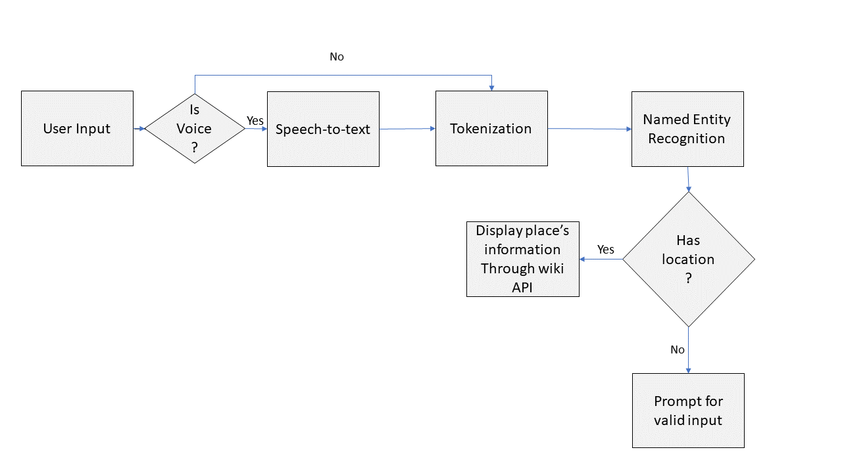
5.SYSTEM ARCHITECTURE

Slide 8




6.TECHNOLOGY STACK
FLUTTER
TENSOR FLOW
PYTHON
ANDROID STUDIO

Slide 9
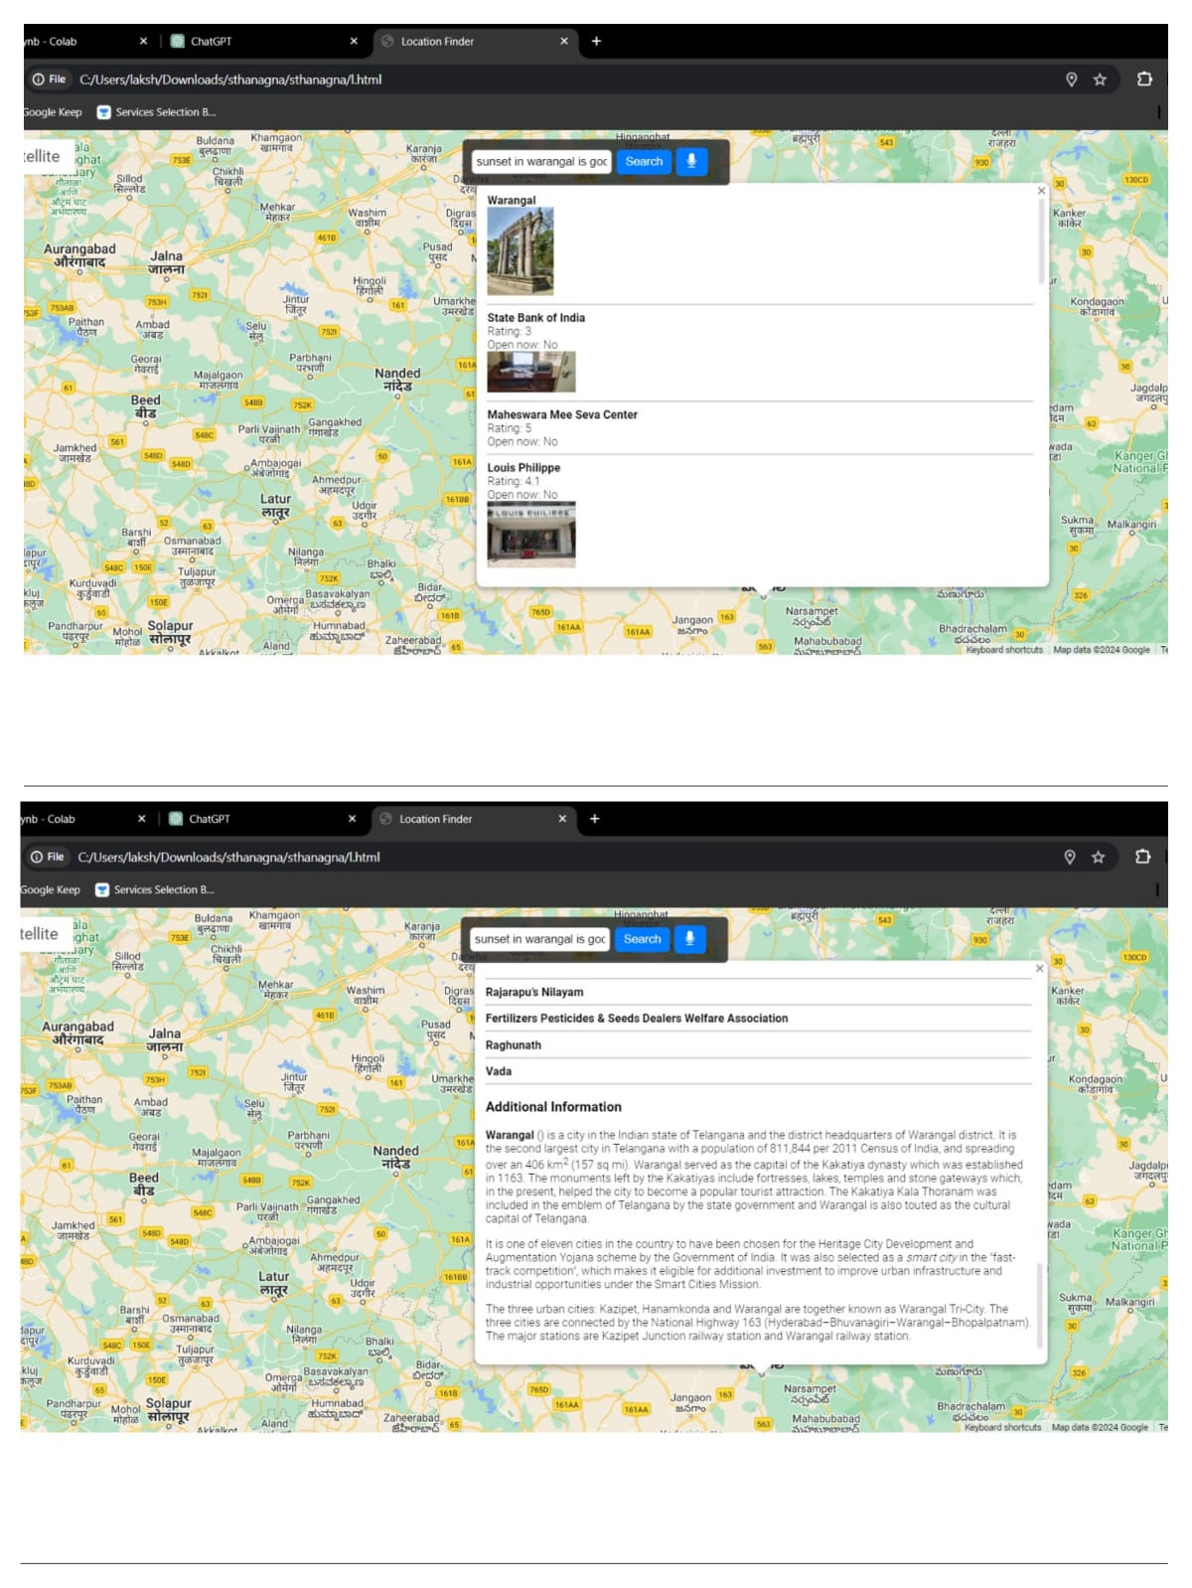
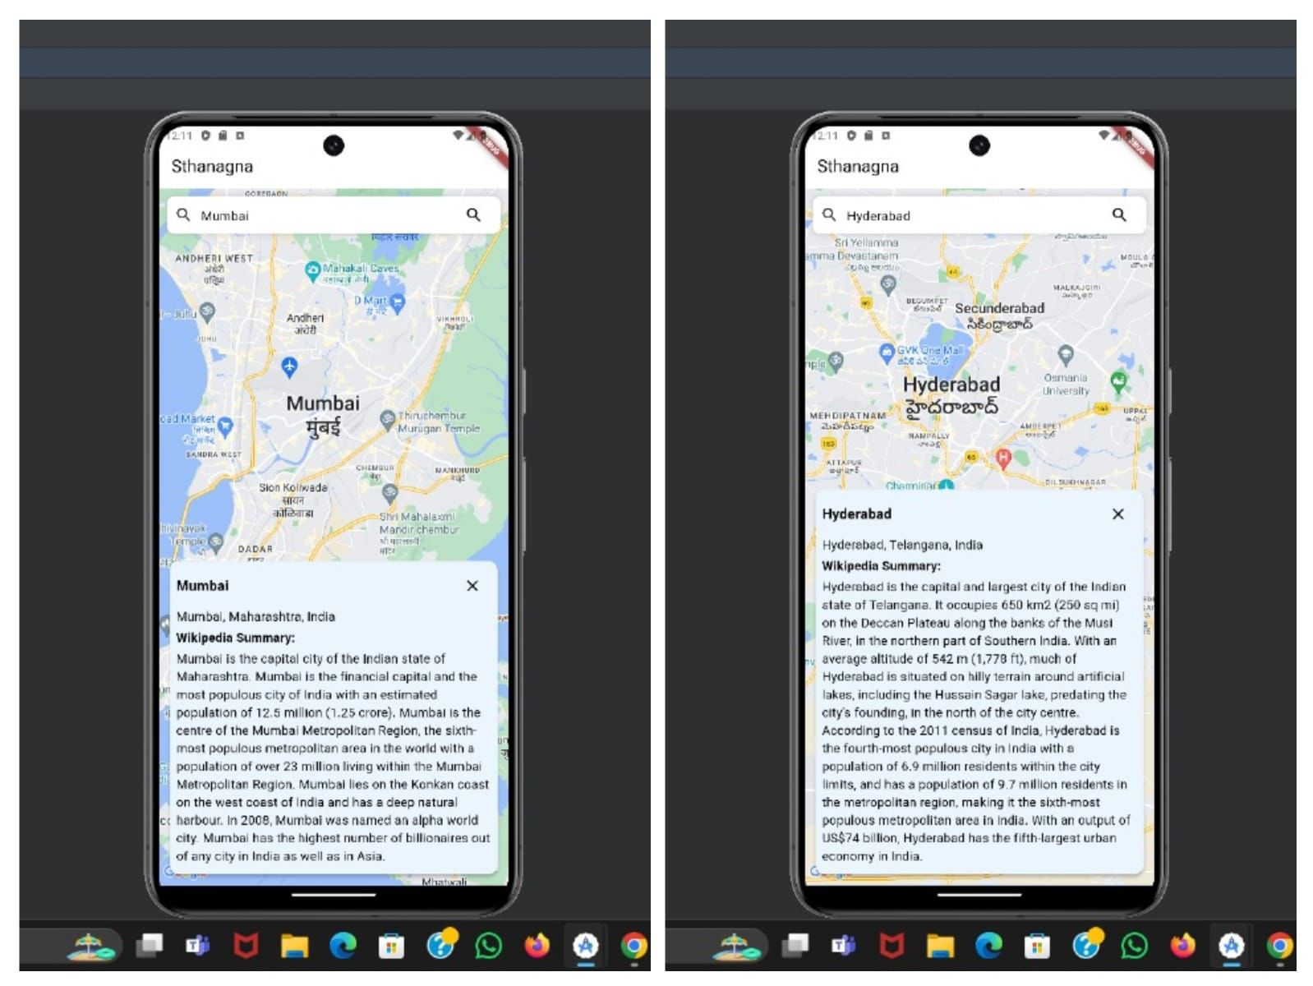
7.RESULTS & SCREENSHOTS

Slide 10
8.CONCLUSION
Our project represents a significant leap forward in information accessibility and retrieval. By
developing an accompanying mobile application, we've extended the reach of our solution to users on
the go, providing seamless access to location-based information anytime, anywhere. This app serves
as a practical tool for users seeking detailed insights into various places, including businesses, landmarks,
educational institutions, and more. Through its intuitive interface and robust features, our app
exemplifies our commitment to enhancing user experiences and addressing real-world needs effectively

Slide 11
9.FUTURE SCOPE
The future scope for our application is promising and multifaceted. We envision incorporating advanced
features such as augmented reality (AR) overlays, enabling users to access immersive experiences and
interactive content while exploring locations. Furthermore, integration with emerging technologies like artificial intelligence (AI) and machine learning (ML) will enhance our recommendation algorithms, providing users with
highly personalized suggestions based on their historical data and behavior patterns. Additionally, expanding our platform to support user-generated content and community-driven features will foster a vibrant ecosystem where
users can contribute their insights, reviews, and recommendations. Ultimately, our goal is to continue innovating and evolving our application to meet the evolving needs and preferences of our users, ensuring a seamless and enriching experience for all.

Slide 12
10.REFERENCES
"Google Maps JavaScript API Documentation" - Google
"Google Places API Documentation" - Google
"Wikipedia API Documentation" - Wikimedia Foundation
"Node.js Documentation" - Node.js Foundation
"Express.js Documentation" - Express.js Contributors
"GitHub Repositories" - Repositories related to Google Maps integrations, Node.js, Express.js, etc.
"Medium Articles" - Articles related to web development, APIs, and JavaScript

Slide 13


